Slide 1









Data-Driven Approach to Improving Efficiency in Hospital Observation Units

Slide 2


TABLE OF CONTENT
1
INTRODUCTION
ISSUE OVERVIEW
DATA DICTIONARY
2
DATA PREPROCESSING
EXPLORATORY DATA ANALYSIS
3
MODEL DEVELOPMENT
PREDICTIVE ANALYSIS
4
RECOMMENDATIONS

Slide 3


INTRODUCTION
Montanaro Hospital, a 260-bed healthcare facility with a 23-bed Observation Unit (OU), is overseen by Dr. Erin Kelly. The OU plays an essential role in managing patient care, specifically for those with complex, non-critical symptoms.
It serves as a vital bridge between the emergency department and full inpatient admission, enabling close monitoring of patients who may not require immediate hospitalization but still need careful observation.

Slide 4


Issue Overview
Inefficient use of resources and prolonged patient stays
Job dissatisfaction among nurses in the OU
Emergency Department overcrowding
Restricted exclusion criteria
Minimal reimbursement from insurance providers

Slide 5

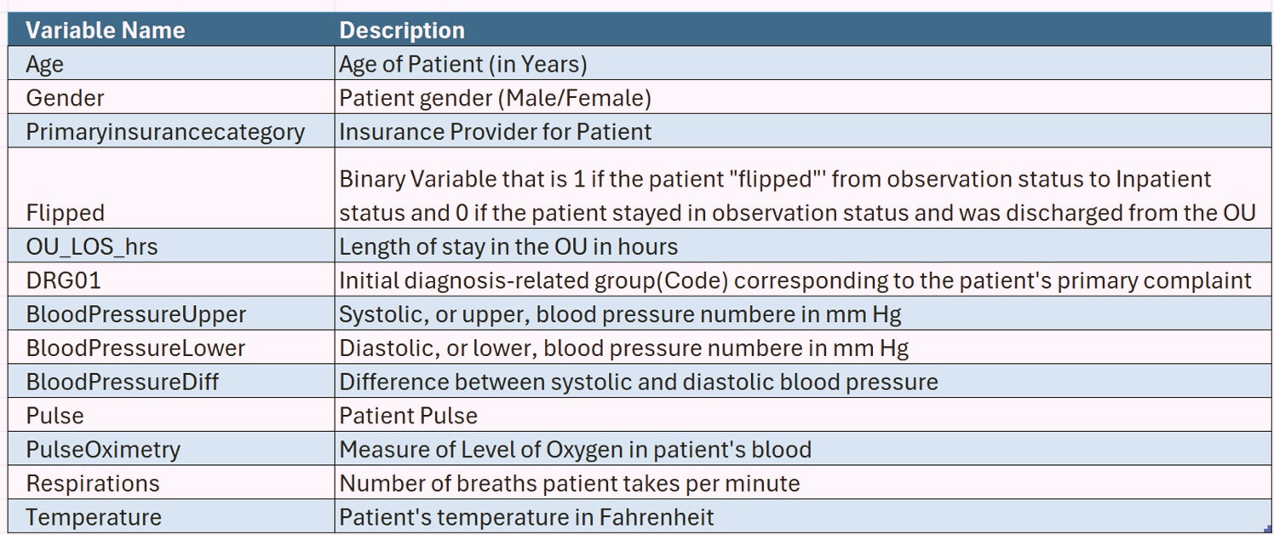
Data Dictionary

Slide 6
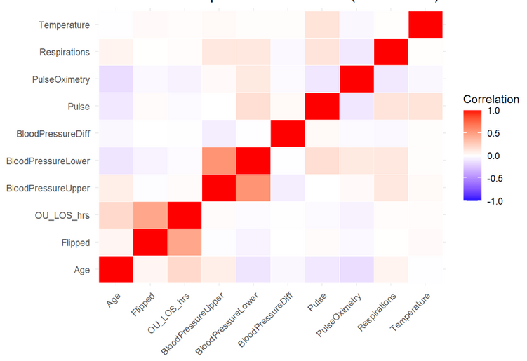
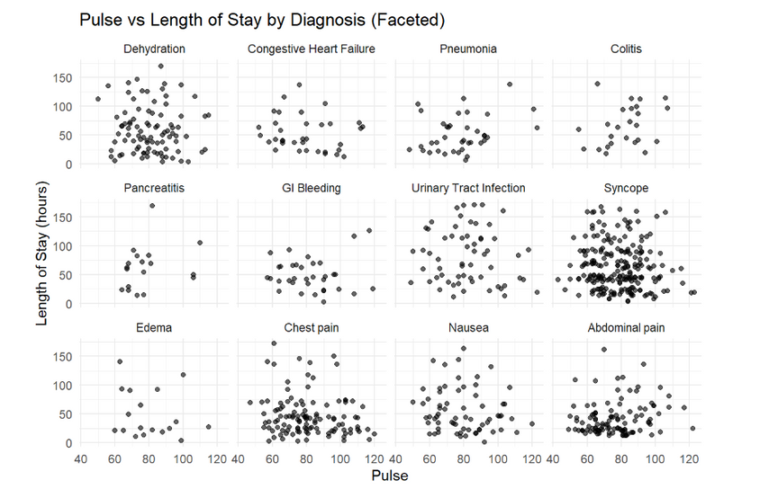
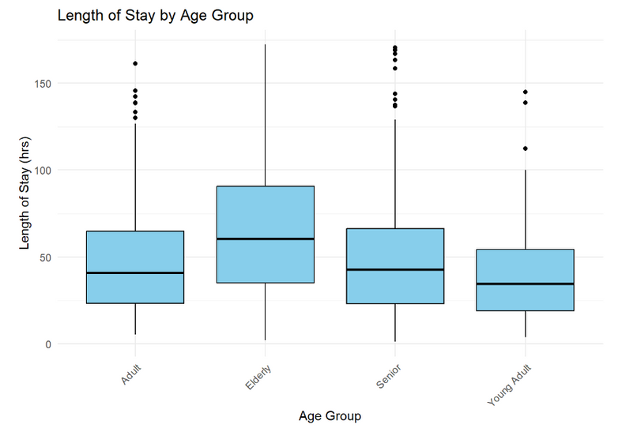
Exploratory Data Analysis

Slide 7
Data Preprocessing
Identification of missing values and outliers
Replacing missing values with mean
Correlation between variables to check multicollinearity
Data partitioning into training and testing datasets

Slide 8

MODEL DEVELOPMENT
LOGISTIC REGRESSION AND RANDOM FOREST MODEL
USING STEPWISE APPROACH, THE FOLLOWING VARIABLES ARE TAKEN INTO ACCOUNT:
BLOOD PRESSURE
TEMPERATURE
LENGTH OF STAY
DRG01

Slide 9


PREDICTIVE ANALYSIS
MODEL | ACCURACY | BASELINE | SPECIFICITY | SENSITIVITY | AUC
Logistic Regression Model | 74.60% | 59.27% | 68.32% | 78.91% | 82%
Random Forest Model | 75% | 59.27% | 76.19% | 73.27% | 82%

Slide 10

FINDINGS & RECOMMENDATIONS
1. Update Admission Criteria
Refine OU admission guidelines to prioritize patients needing short-term observation, reduce unnecessary admissions, and improve Emergency Department flow.
2. Continuous Performance Monitoring
Track key metrics to identify trends, optimize resource use, and adjust criteria for better OU efficiency and patient outcomes.

Slide 11
Thank you!

Slide 12
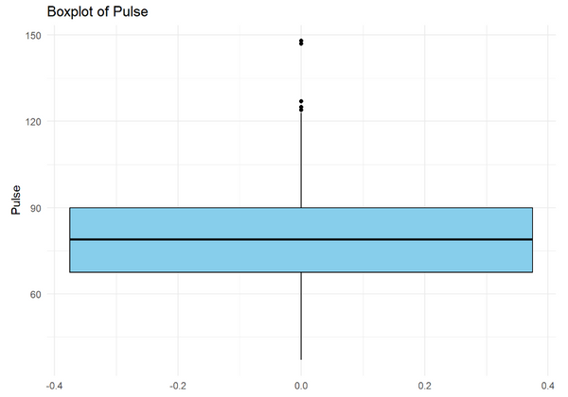
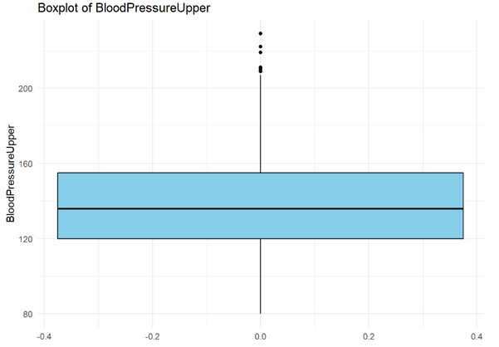
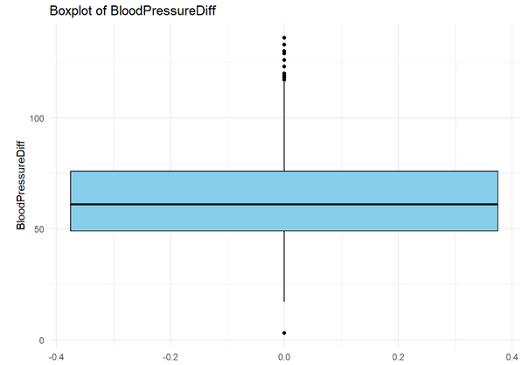
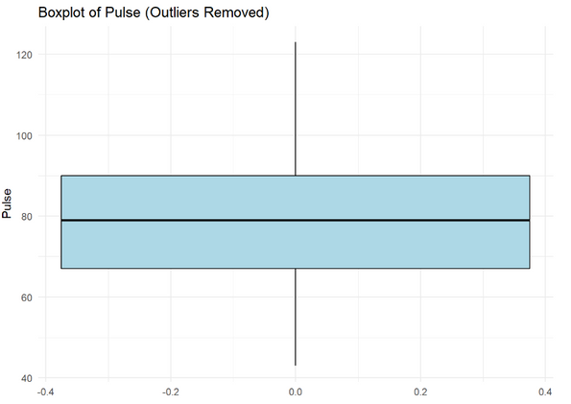
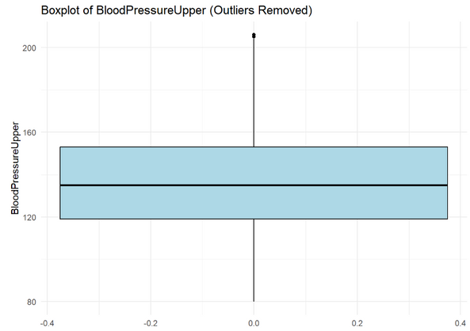
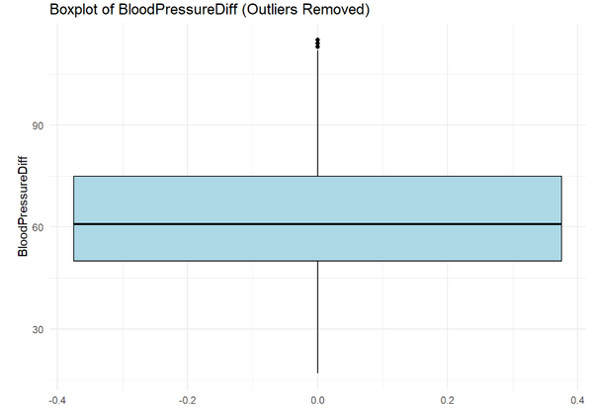
Appendix

Slide 13
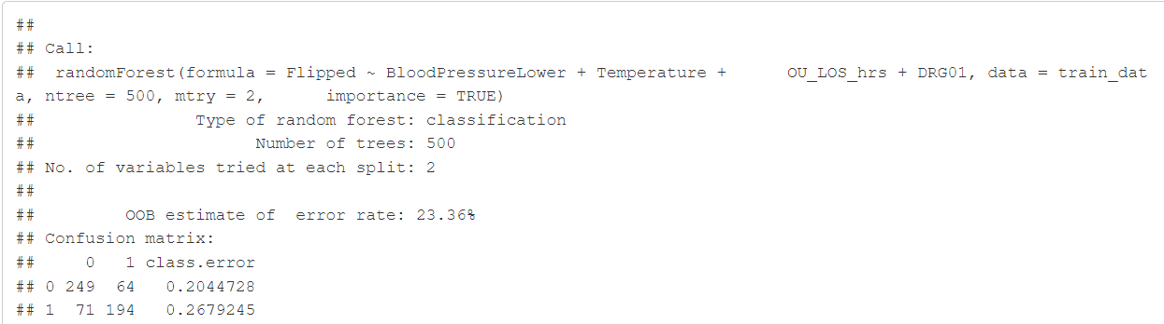
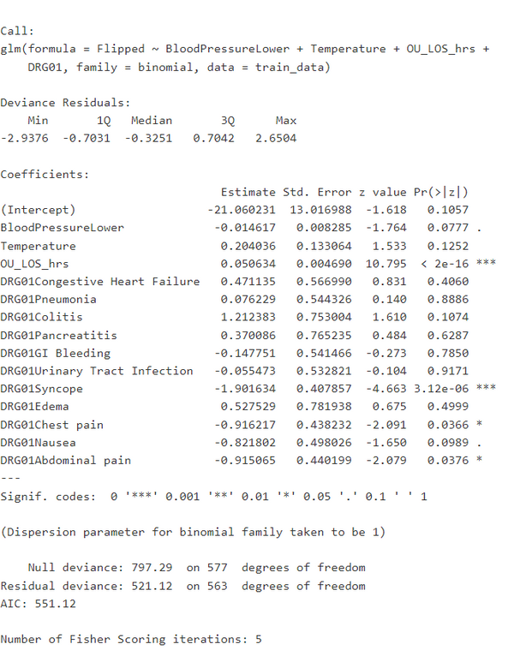
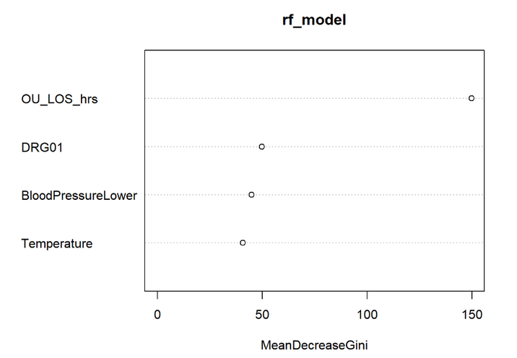
Appendix
Logistic Regression Model Result
Random Forest Model Result
Variable Importance Plot

Slide 14
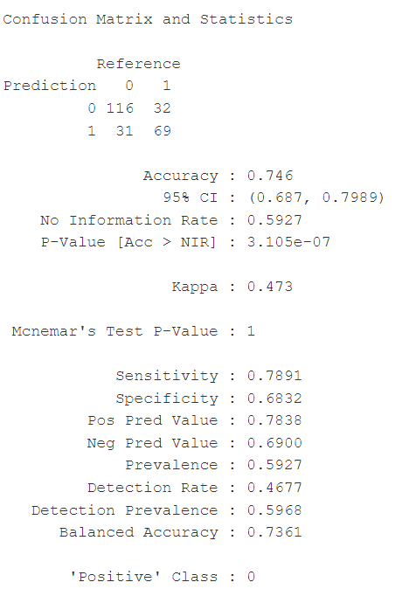
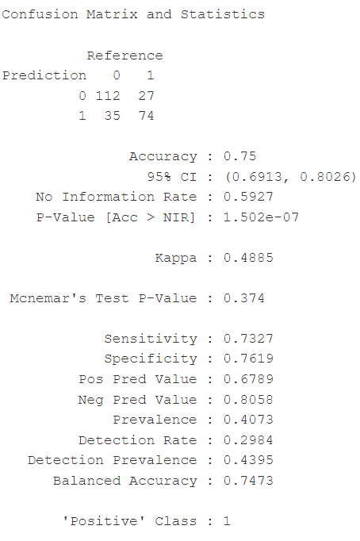
Appendix
Logistic Regression Confusion Matrix
Random Forest Confusion Matrix

Slide 15
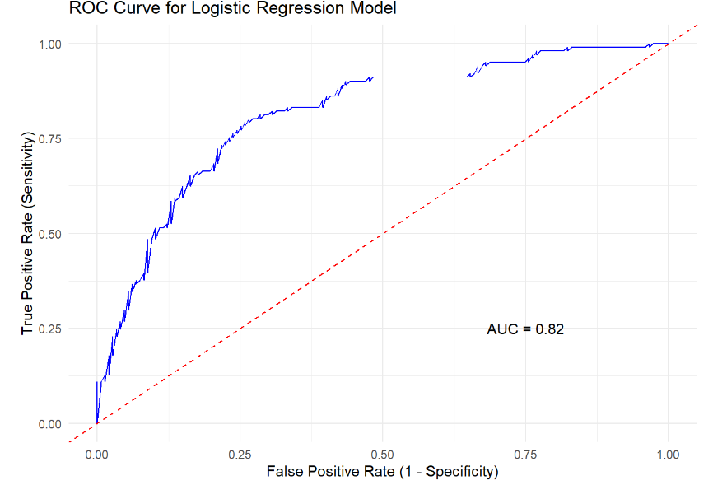
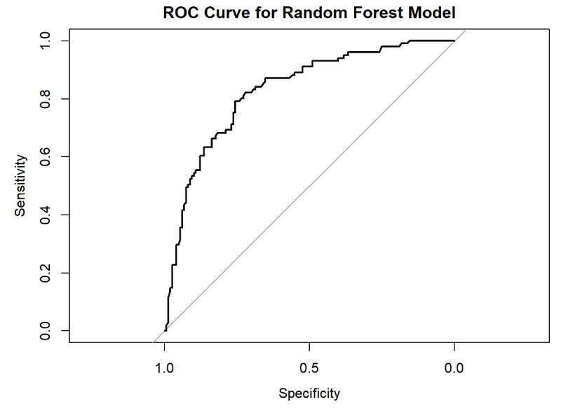
Appendix
ROC Curve for Logistic Regression
ROC Curve for Random Forest

